Slide 1
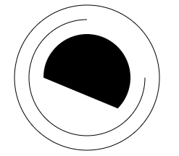
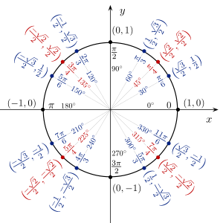
150
Math.PI*１=π=180°
60
Math.PI*0.25=π/4=45°
200
ctx2.arc(200, 150, 60, Math.PI * 0.25, Math.PI * 1, false)

